Slide 1
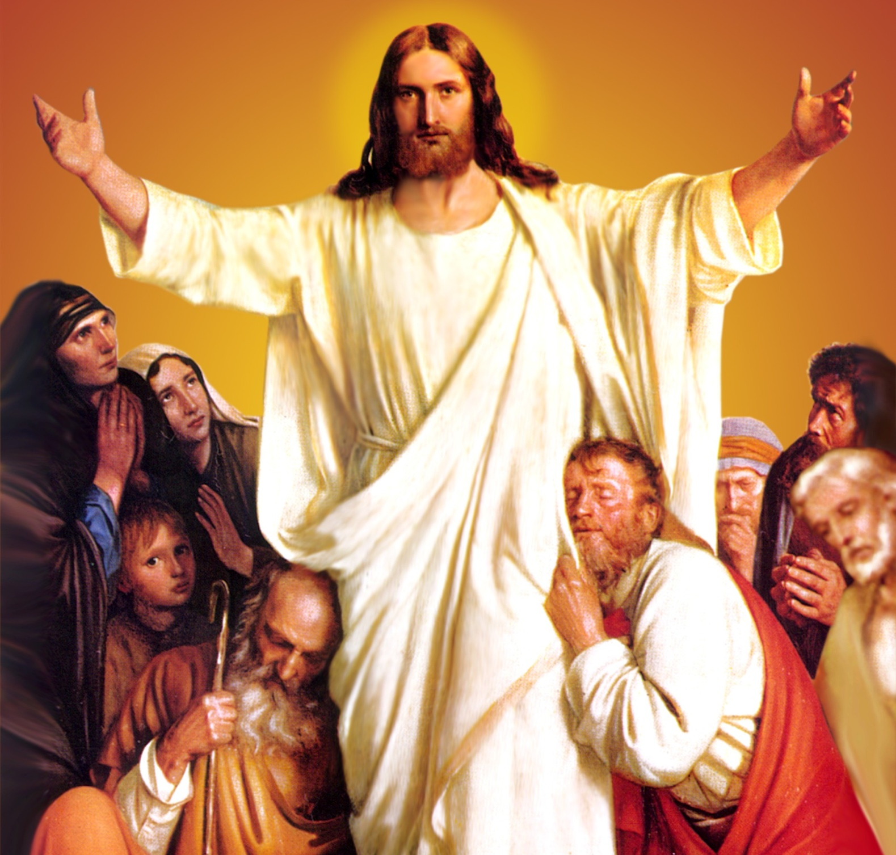
CATECHETICAL TEXTBOOK SERIES OF THE SYRO - MALABAR CHURCH
ON THE PATH OF SALVATION - 6
PEOPLE WHO
EXPERIENCED JESUS
6

Slide 2
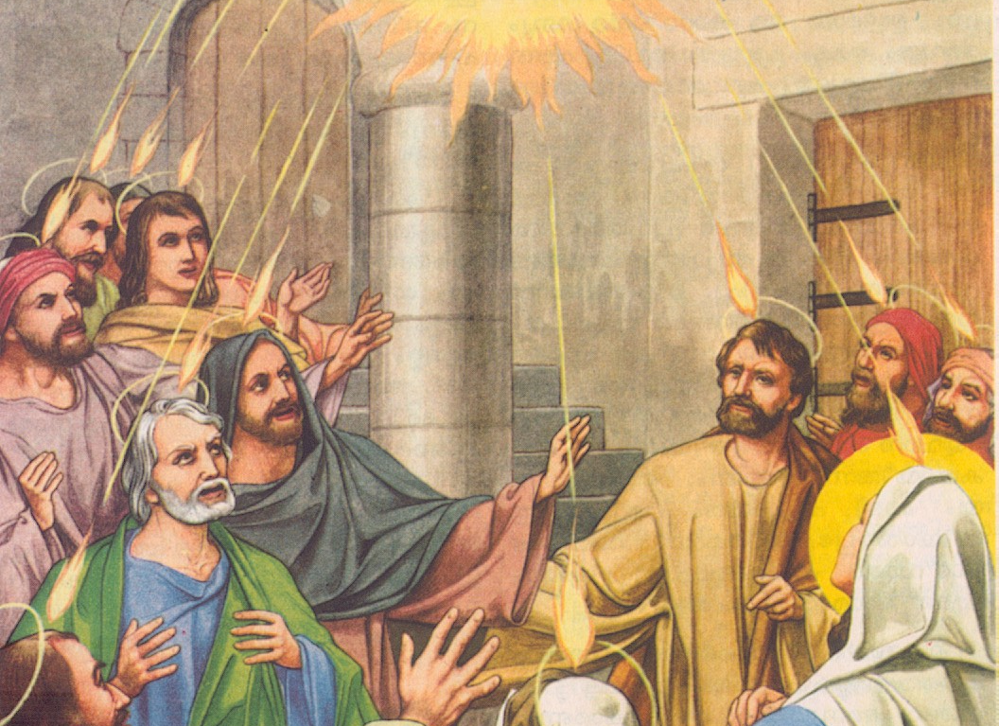
LESSON 14
PENTECOST AND THE PROCLAMATION OF FAITH

Slide 3
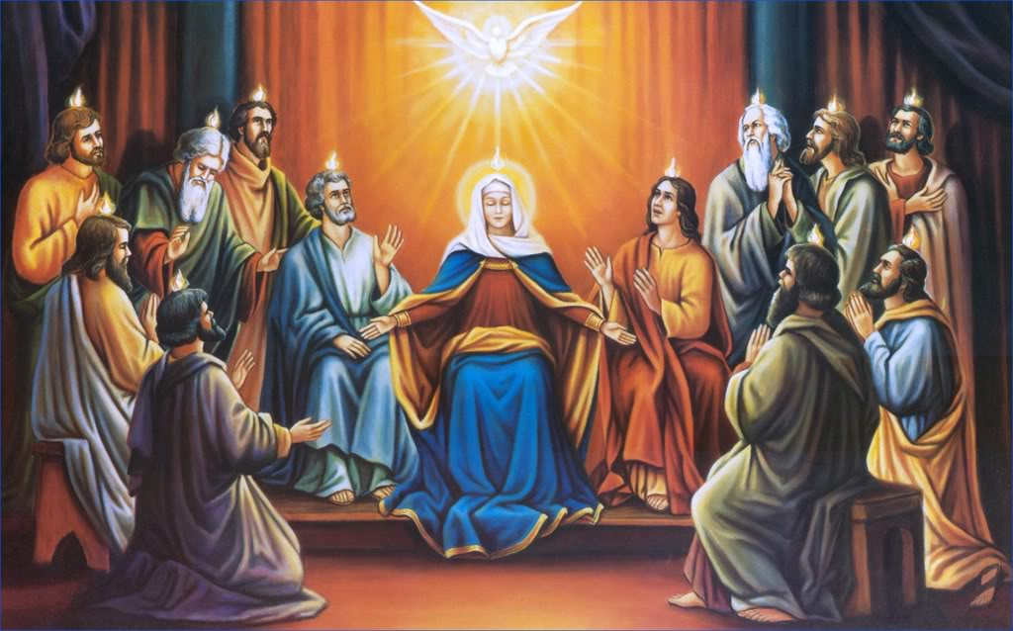
They saw tongues flame-like-tongues staying over each of them. They were all filled with the Holy Spirit. By the gift of tongue they received from the Spirit, they began to talk in different languages.

Slide 4
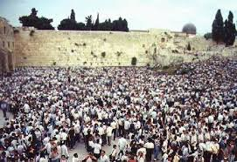
There were devout jews from every nation living in Jerusalem
And at this sound the crowd gathered and was bewildered, because each one heard them speaking in the native language of each. They were amazed and astonished.

Slide 5
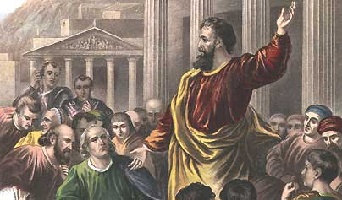
PETER’S SERMON
Peter got up and addressed them saying…..
These people are not drunk as you think. God declares; I will pour out my spirit upon all flesh, And your sons and your daughters shall prophesy, And your young men shall see visions, And your old men shall dream dreams. In those days I will pour out my spirit Even upon my slaves, both male and female, And they shall prophesy. (Acts 2:14-21; Joel 2: 28-29)

Slide 6
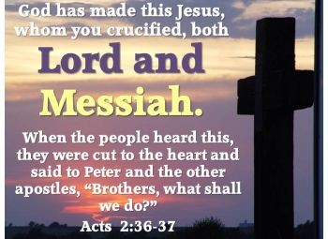
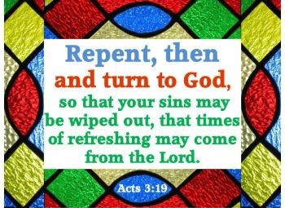
PETER EXPLAINED TO THEM :
Jesus the son of god.
Jesus brought us salvation through passion and death.
God the father raised him from death.

Slide 7
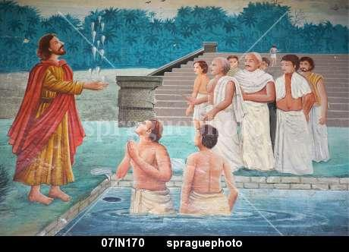
THOMAS APOSTLE IN INDIA
Apostle Thomas, called the Didimus, came to India.
St. Thomas reached in the Year 52 A.D in Kodungallor, then called Musiris.
On 21 November we commemorate the arrival of St. Thomas in India.

Slide 8
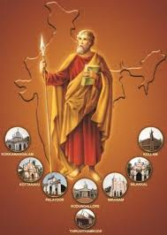
THE SEVEN CHURCHES
St. Thomas established seven churches in India.
He laid the foundation for Christian communities
in seven places.
Niranam
Kollam
Palayoor
Nilackel
Koackamangalam
Koattackavu
Kodungalloor
Thiruvithamkode is known as Arappally.

Slide 9
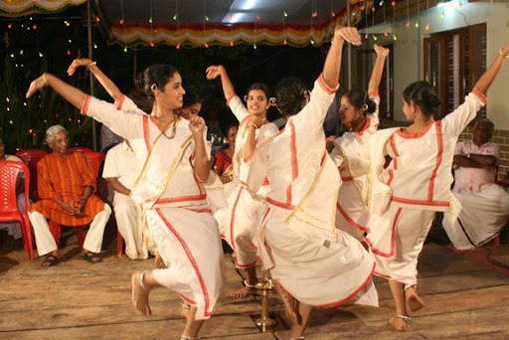
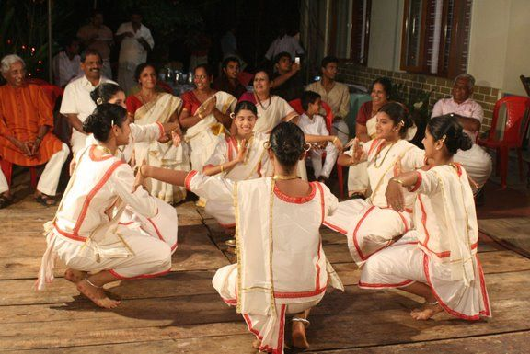
MARGAM KALI
Several ancient forms of art, unique to Syrian Christians, such as Margam Kali, Chavittu nadakam, Paricha muttu kali as well as some ancient songs; bear witness to the missionary work of St.Thomas in India.0

Slide 10
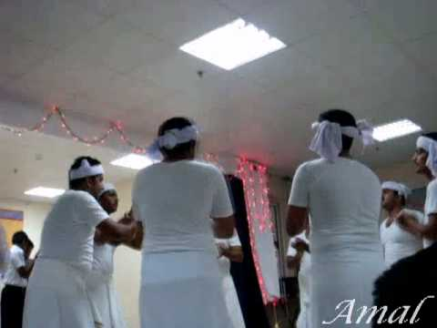
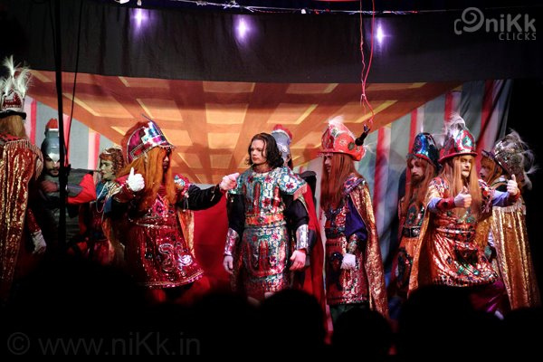
PARICHA MUTTU KALI
CHAVITTU NADAKAM

Slide 11
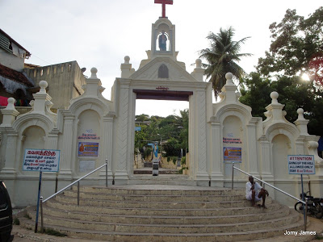
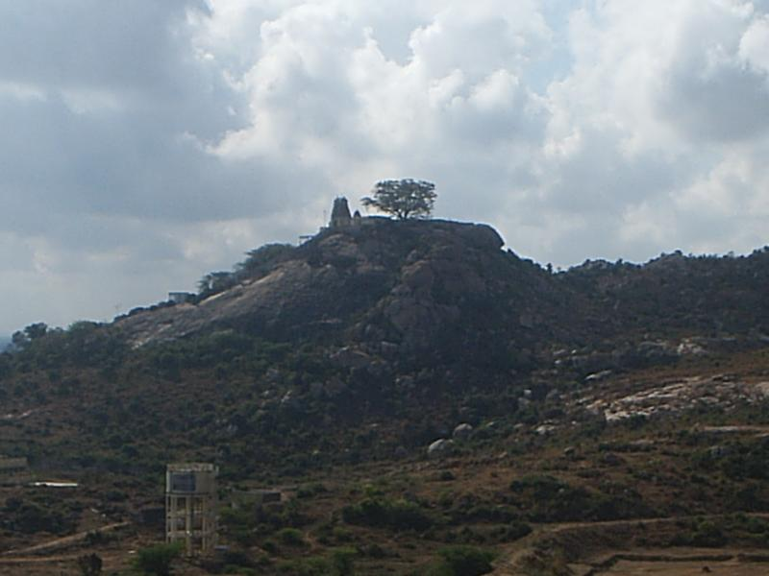
ST. THOMAS
In 72 A.D. Thomas apostle was martyred in Chinna mala (little mount) of Mylapore, wounded by enemy’s spear.
He was buried in Periyamala (Big Mount).
Christian Community commemorate this martyrdom on 3rd July as a feast called Dukrana.
In 1972, during the 19th centenary celebration of this, Pope Paul VI declared him the apostle of India.
Periyamala (Big Mount)
Chinna mala (Little Mount)

Slide 12

KAITHAKKALAM (SUMMER SEASON)
STARTS SEVEN WEEKS AFTER PENTECOST.
THIS DAY WE CELEBRATE THE FEAST OF 12 APOSTELES.
APOSTLES FORM THE FOUNDTION OF THE CHRUCH.
WE REMEMBER THE GROWTH OF THE CHURCH, A SYMBOL OF THE KINGDOM OF HEAVEN, PRODUCING AN ABUNDANCE OF FRUITS OF SANCTITY.

Slide 13
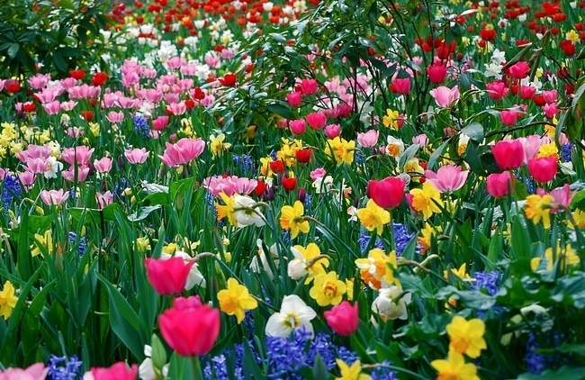
THE SYRIAC WORD KAITHA MEANS SUMMER.
THIS PERIOD IS ALSO KNOWN AS THE SEASON OF FRUITS.
ON THE FRIDAYS OF THIS SEASON WE REMEMBER THE SAINTS AND MARTYRS.
THIS SEASON MOTIVATES US TO PRODUCE GOOD FRUITS OF SANCTITY.

Slide 14
Let us pray
O! Jesus, like St. Thomas theApostle who came to India to proclaim your Gospel, give us also the missionary zeal to proclain your Gospel in India.

Slide 15
Read the word of god:
Acts 2:1-47

Slide 16
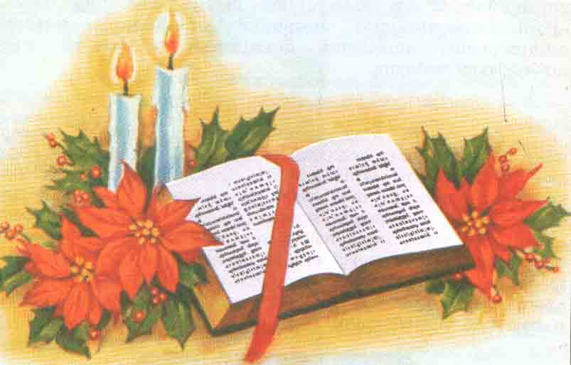
WORD OF GOD FOR GUIDANCE
They devoted themselves to the apostlet teachings and fellowship, to the breaking of bread and the prayers (Acts. 2:42).

Slide 17
LET US DO:
Write the names of seven churches established by
St Thomas the Apostle.

Slide 18
MY DECISION
I will live by doing good acts following the inspirations of the holy Spirit.

Slide 19
LET US Find out the answer
1. Which prophecy of Prophet Joes was realized on the day of Pentecost?
2. What answer did Peter give to those who asked him: What shall we do now?
3. When and where did st. Thomas the Apostle land in India?
4. Which are the Ecclesial communities established by St. Thomas the Apostle?
5. What does the season of Kaitha remind us?

Slide 20
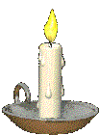


Thank you

